Slide 1

Tracking the COVID19 Outbreak
By: Prajakta Galvankar
Lujane Abdelgadir

Slide 2

Tracking the COVID19 Outbreak
By: Prajakta Galvankar
Lujane Abdelgadir

Slide 3

Tracking the COVID19 Outbreak
By: Prajakta Galvankar & Lujane Abdelgadir

Slide 4
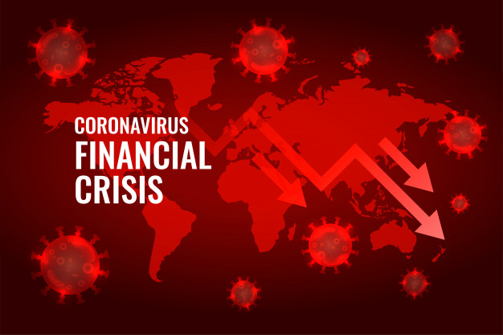
Tracking the COVID19 Outbreak
By: Prajakta Galvankar
Lujane Abdelgadir

Slide 5

Tracking the COVID19 Outbreak
By: Prajakta Galvankar & Lujane Abdelgadir

Slide 6
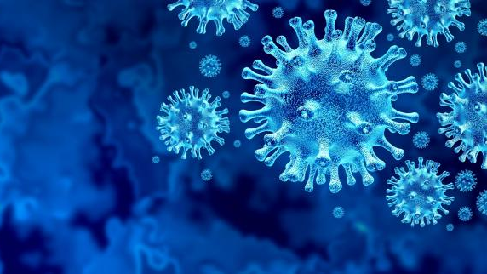
Tracking the COVID19 Outbreak
By: Prajakta Galvankar & Lujane Abdelgadir

Slide 7
Tracking the COVID19 Outbreak
By: Prajakta Galvankar
Lujane Abdelgadir

Slide 8

Tracking the COVID19 Outbreak
By: Prajakta Galvankar & Lujane Abdelgadir

Slide 9

Tracking the COVID19 Outbreak
By: Prajakta Galvankar & Lujane Abdelgadir

Slide 10

Tracking the COVID19 Outbreak
By: Prajakta Galvankar & Lujane Abdelgadir

Slide 11

Tracking the COVID19 Outbreak
By: Prajakta Galvankar & Lujane Abdelgadir

Slide 12
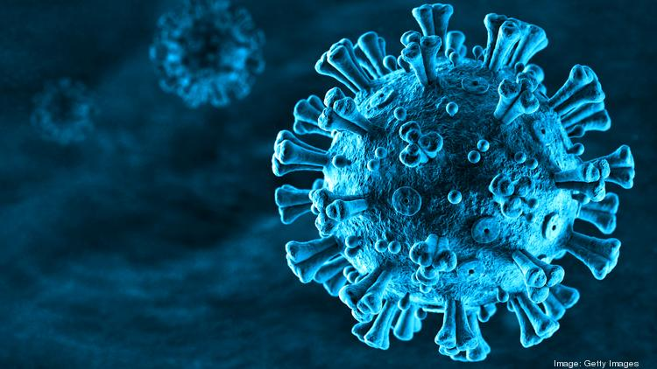
Tracking the COVID19 Outbreak
By: Prajakta Galvankar & Lujane Abdelgadir

